Slide 1

Kickstarter Vs COVID-19
Insight into the success of crowdfunding and how it has changed in the united states.
Joseph Menesch | Lalith Veerabhadrappa Badiger
Jihita Sri Koya | Jarrad Down | Group 13

Slide 2
“When I look at Kickstarter, I see small businesses that have been funded by their customers. I see the acceleration of this shift away from the industrial manufacturing ideology to more of a maker economy. And I also see an idea so powerful that the company name has become a verb.”
- Om Malik, Tech Journalist
Notes:
(Briefly Explain Kickstarter)

Slide 3
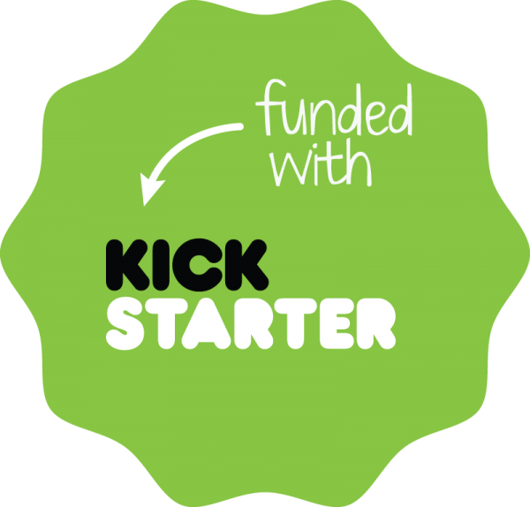
The Problem
COVID-19 changed all aspects of life
Changed how we spend money
Kickstarter is a service that thrives on generosity and interest
Spending capacity of the world may drastically influence success
Questions we sought to answer
How can we measure success?
What can we use to give insight into what makes success?
Can we predict success?
How has all the above changed due to COVID-19?
Design Thinking
Data Acquisition
Data Curation
Data Exploration
Model Creation
The Story
Future Improvements

Slide 4

Acquiring the Data Needed
Web Robots© performs monthly web-scraping of Kickstarter
Large variety of data
Semantic data about project
Performance indicators (pledged amount, number of backers)
Dates pertaining to operation of campaign
Links to photos and reward tier information
Required to perform our own web-scraping
Using URLs in data, web-scraped reward tier information (costs and backers of each tier)
Design Thinking
Data Acquisition
Data Curation
Data Exploration
Model Creation
The Story
Future Improvements

Slide 5
Fitting Data for Use
Nearly 208,000 rows before cleaning, ~36,000 after
Major reduction in size, convenient to work with data
Several filters applied
Only campaigns created after January 1st, 2019 (recent data)
Only campaigns in the US
Ignore active campaigns, they are not complete information
Duplicates present (removed via ID)
Web-scraped Reward-tier data decomposed from JSON to comma-separated string
Design Thinking
Data Acquisition
Data Curation
Data Exploration
Model Creation
The Story
Future Improvements

Slide 6
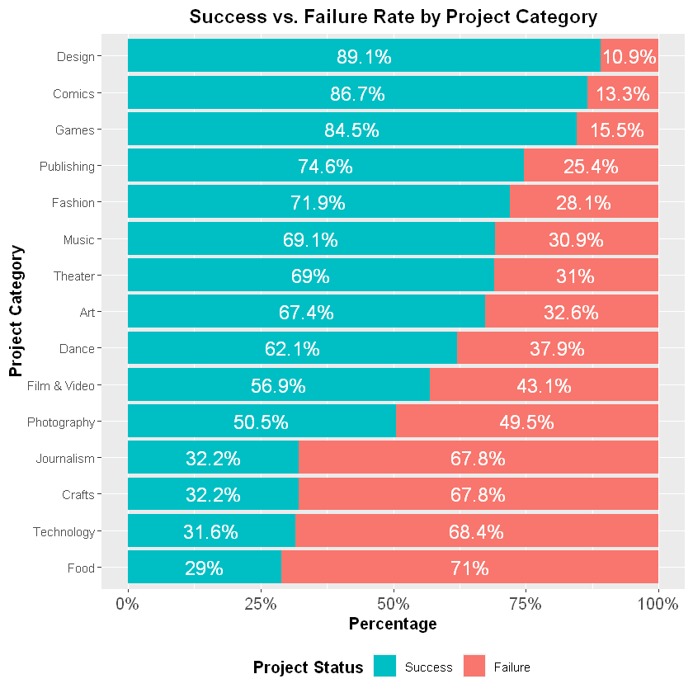

Discovering Features
Kickstarter has highest number of projects originating from the USA.
Overall, 63.9% of the projects were found to be successful, 30.2% failed and 5.9% which are still live.
The success rate of the project is inversely proportional to the goal set by the creator.
The most popular categories by count are Games, Technology and Art.
Average amount pledged per backer is the highest in Technology, followed by design. Games is among the lowest.
Design Thinking
Data Acquisition
Data Curation
Data Exploration
Model Creation
The Story
Future Improvements
Notes:
We got the following insights from our analysis:

Slide 7
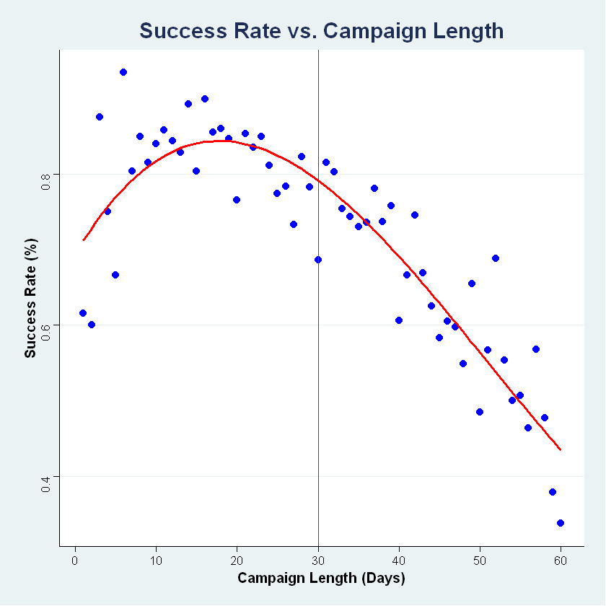
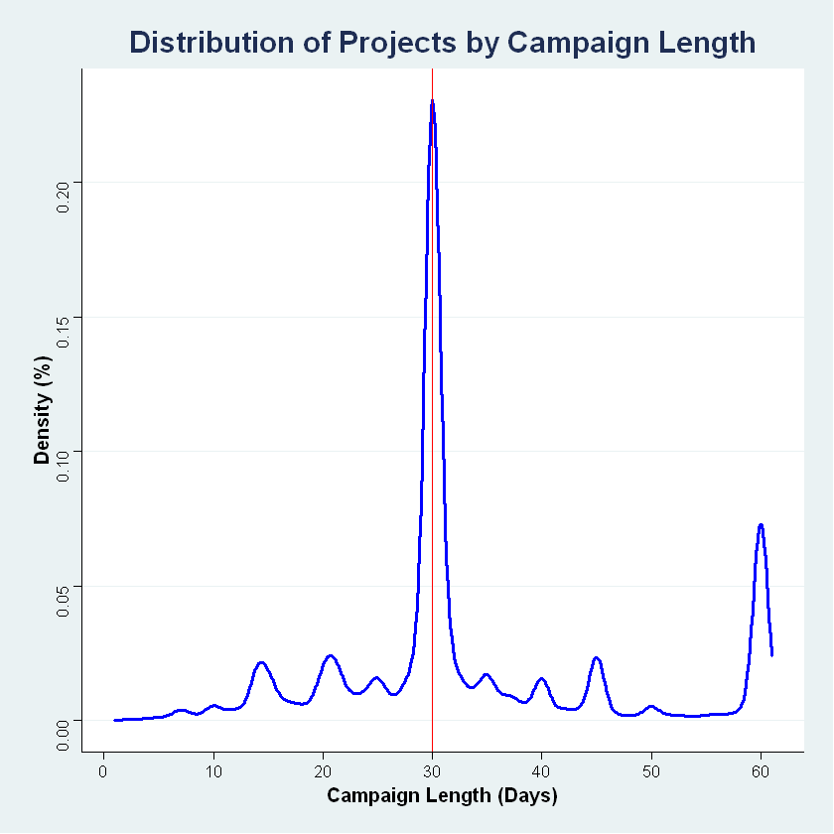
Discovering Features
“Projects on Kickstarter can last anywhere from 1 - 60 days. We've done some research, and found that projects lasting any longer are rarely successful. We recommend setting your campaign at 30 days or less.” - Kickstarter
Design Thinking
Data Acquisition
Data Curation
Data Exploration
Model Creation
The Story
Future Improvements
Notes:
The quote on the slide taken from the official Kickstarter website, “Projects on Kickstarter can last anywhere from 1 - 60 days. We've done some research, and found that projects lasting any longer are rarely successful. We recommend setting your campaign at 30 days or less.”
So, to test this claim, we plotted campaign length vs success rate with a non-linear regression of 3rd order polynomial, and found out that the success rate during the initial few days is higher. After 30 days the probability of the project reaching its goal in significantly reduced.
From the second plot we can see a peak at 30th day which is the recommended length by Kickstarter.
Our theory is that having more time does not create a sense of urgency. Instead it makes it easier for backers to procrastinate, and sometimes they forget to come back at all. When a project launches the creator’s fans rush to show their support which is reflected here.
Ref: https://help.kickstarter.com/hc/en-us/articles/115005128434-What-is-the-maximum-project-duration-#:~:text=Projects%20on%20Kickstarter%20can%20last,at%2030%20days%20or%20less.

Slide 8
Making the Data Confess
Variables
Success measures:
State (Successful or Failed)
Ratio of pledged to goal
Number of backers
Top predictors (via feature analysis):
Number of reward tiers
Goal
Campaign length
Cost of reward tiers
Design Thinking
Data Acquisition
Data Curation
Data Exploration
Model Creation
The Story
Future Improvements

Slide 9
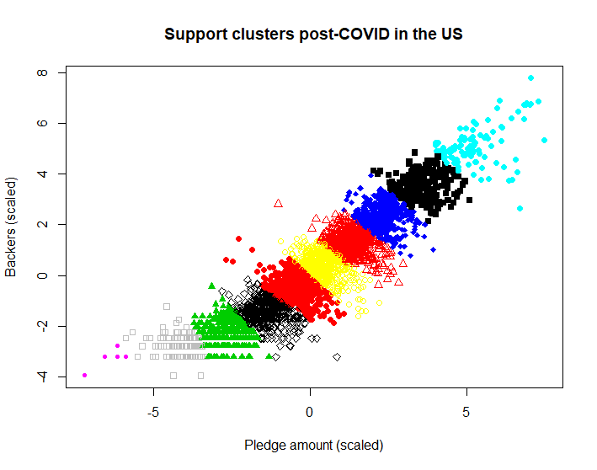
Making the Data Confess
Sub-optimal models
Logistic regression for number of tiers
Class imbalance – low specificity
k-NN classification for reward cost info
Low statistical power
K-means clustering for category trends
Little notable cluster information
Design Thinking
Data Acquisition
Data Curation
Data Exploration
Model Creation
The Story
Future Improvements

Slide 10
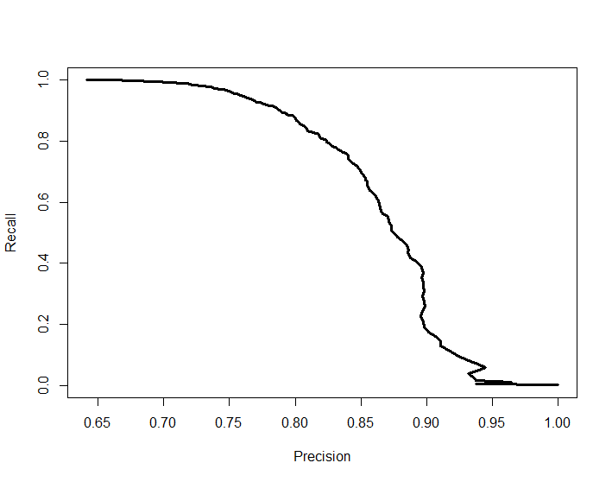
Making the Data Confess
Random Forest – Pre-COVID
(Bal) Accuracy = 74% (P<0.001)
Sensitivity (Recall) = 88%
Specificity = 59%
PPV (Precision) = 80%
NPV = 74%
Best predictors:
Number of reward tiers
Goal amount
Campaign length
1st quartile of reward costs
3rd quartile of reward costs
Precision-recall curve (Pre-COVID)
N = 4425 |  | Reference
 |  | Failed | Successful
Prediction | Failed | 946 | 329
 | Successful | 640 | 2510
70/30 training/test split
Design Thinking
Data Acquisition
Data Curation
Data Exploration
Model Creation
The Story
Future Improvements

Slide 11
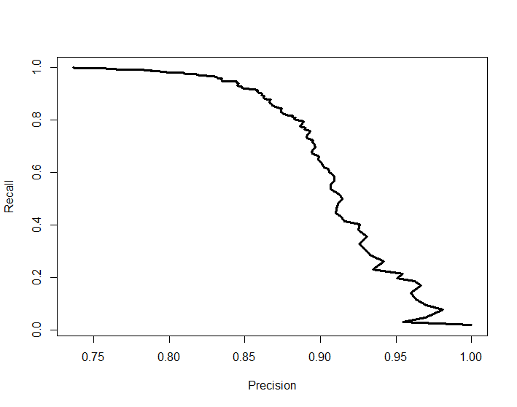
Making the Data Confess
Random Forest – Post-COVID
(Bal) Accuracy = 73% (P<0.001)
Sensitivity (Recall) = 92%
Specificity = 53%
PPV (Precision) = 85%
NPV = 72%
Best predictors:
Number of reward tiers
Goal amount
Campaign length
3rd quartile of reward costs
Maximum reward cost
Precision-recall curve (Post-COVID)
N = 930 |  | Reference
 |  | Failed | Successful
Prediction | Failed | 131 | 50
 | Successful | 114 | 635
70/30 training/test split
Design Thinking
Data Acquisition
Data Curation
Data Exploration
Model Creation
The Story
Future Improvements

Slide 12
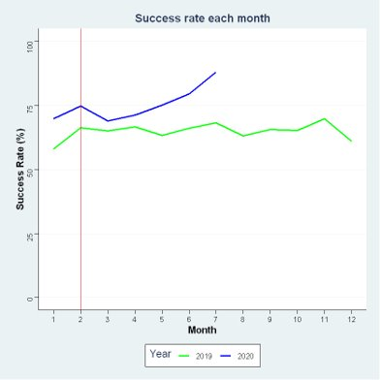
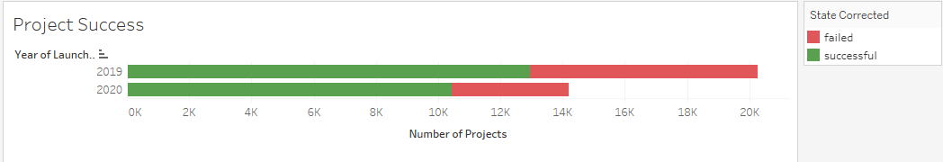
The Journey to Success
Increase in success rate post Covid
Number of projects launched has reduced during the outbreak and later increased
Measures of success like the Backer count and Pledged amount were also impacted after the Covid outbreak.
Design Thinking
Data Acquisition
Data Curation
Data Exploration
Model Creation
The Story
Future Improvements

Slide 13
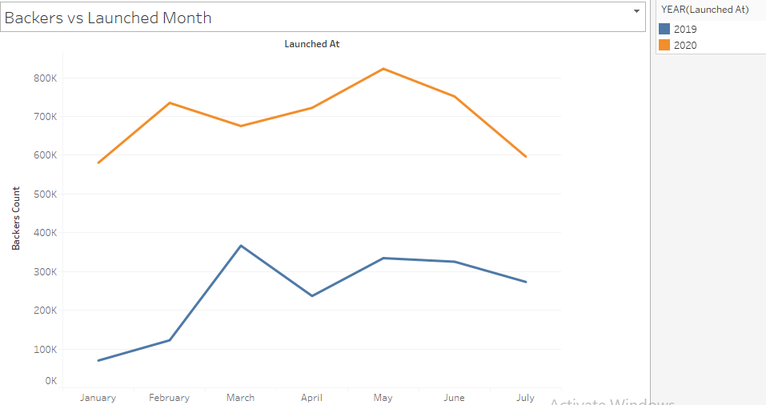
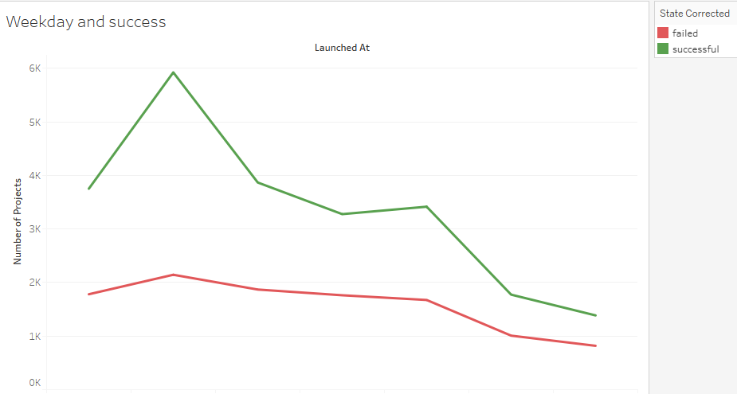
The Journey to Success
Number of backers have increased even after the Covid outbreak
Projects launched during the start of week are successful than later in the week
Design Thinking
Data Acquisition
Data Curation
Data Exploration
Model Creation
The Story
Future Improvements

Slide 14
Future Improvements & Extensions
COVID-19 is ongoing
Future data will produce better insights & predictions
Web Robots continues to scrape monthly
Model comparisons between Kickstarter and other crowd-funding services
Is Kickstarter the winner or is it crowd-funding?
Colour Analysis of Campaign Marketing
Do people respond to colours differently?
Design Thinking
Data Acquisition
Data Curation
Data Exploration
Model Creation
The Story
Future Improvements

